Slide 1
Inferential Statistical Analysis

Slide 2

Review of the Previous Lesson

Slide 3
Z test
Is a statistical test to determine whether two population means are different when the variances are known and the sample size is large.
It can used to test hypothesis.

Slide 4
One-sample T-test
Used to test whether a population parameter is significantly different from some hypothesized value.

Slide 5

Z test one sample

Slide 6
Two Sample Z test
A hypothesis test that is used to compare two sample groups to determine if they have originated from the sample population.

Slide 7
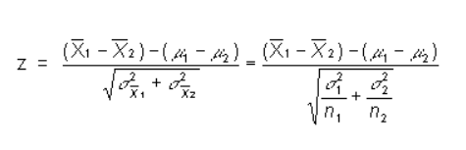
Z test two samples

Slide 8
Steps to Follow
Choose your test
Statistical Hypothesis
Level of Significance
Critical Value
Calculate the Test Statistic
Statistical Decision
Resume the Situation

Slide 9
Sample
Twenty-five high school students complete a preparation program for taking the SAT test. The population average for SAT scores is 500 with a population standard deviation of 100. Here are the SAT scores from the 25 students who completed the SAT prep program:
434 694 457 534 720 400 484 478 610 641 425 636 454
514 563 370 499 640 501 625 612 471 598 509 531

Slide 10
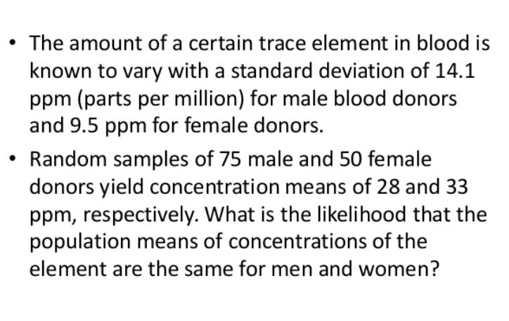
Sample
Alpha Level = 5%

Slide 11
Sample
According the U.S. Department of Education, full-time graduate students receive an average salary of $12,800. The dean of graduate studies at a large state university in PA claims that his graduate students earn more than this. He surveys 46 randomly selected students and finds their average salary is $13,445 with a standard deviation of $1800. With alpha = 0.05, is the dean’s claim correct?

Slide 12
Sample
A health researcher read that a 200-pound male can burn an average of 524 calories per hour playing tennis. 37 males were randomly selected, and the mean number of calories burned per hour playing squash was 534.8 with a standard deviation of 45.9 calories. Do squash players burn more calories per hour than tennis players? Test with alpha = 0.01.

Slide 13
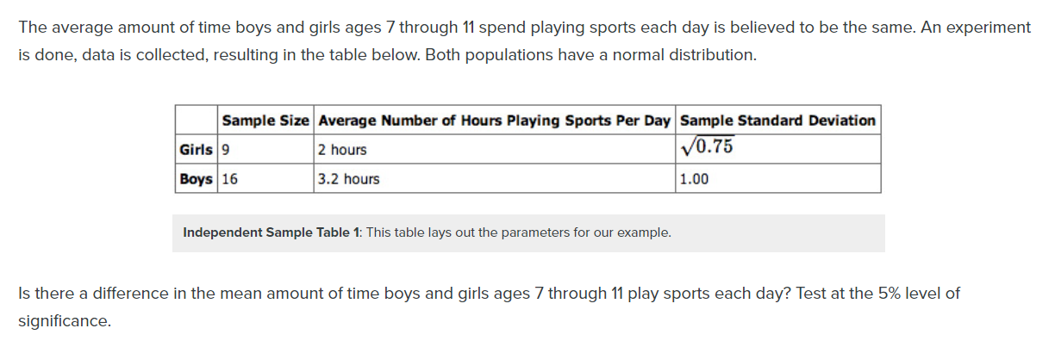
Sample

